Slide 1
Orange Services IT Bootcamp
AI Workshop
Intro in Artificial Intelligence & ML
Andrei Gabriel Popescu ~ Data Scientist

Slide 2
About this Bootcamp

Slide 3
Content
Intro to AI
AI vs ML vs DL
Why the recent popularity ?
---
What do we need for AI in industry ?
What are we using at OSE ?
What it is in for you ?
---
Intro to clustering
Code session

Slide 4
Intro to AI
- Web search !!
Nowadays, AI has become the most used term in Business meetings all around the world. But the whole idea started way back in the 60’s when people thought that computers could be more useful one day.

Slide 5
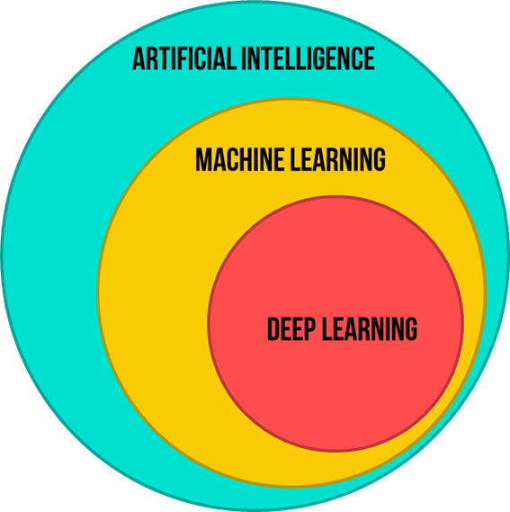
AI vs ML vs DL
AI is the broadest concept of all, and gives a machine the ability to imitate human behavior.
ML is the application of AI into a system or machine, which helps it to self-learn and improve continually.
Lastly, DL uses complex algorithms and deep neural networks to repetitively train a specific model or pattern

Slide 6
Why the recent popularity ?
- OpenAI
- Tesla
- Google
- Meta
Mostly because is new, in the industry.
We can see AI as the new Electricity – should be used everywhere but people are scared.
Also, can generate a lot of money :D

Slide 7
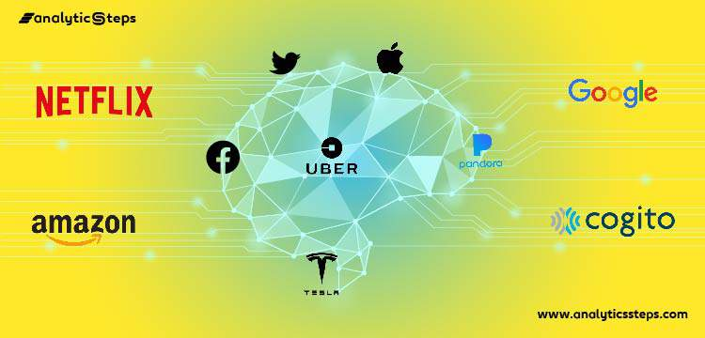
AI in industry

Slide 8
New industry, new opportunities
What it is in for you ?
This industry of data gathering and insights created new roles such as: Cloud Data Engineer, Data Scientist, ML Engineer, ML Researcher, Applied Scientist etc.

Slide 9
AI Course structure
Clustering
Classification
Regression
Intro to NN (neural networks) w/ PyTorch
- The optional assignment is on!!
Generative models
Anomaly detection - use case
- The optional assignment presentation!
---
At the end of the course we will have a test :/
For questions you can contact me:
- Andrei.popescu@orange.com

Slide 10
Clustering
- Clustering is a form of unsupervised learning.
The objective of clustering is to group similar data together and discover patterns. K-Means is doing this by assigning a cluster point to all the data and then move them.
In other words, the K-means algorithm identifies k number of centroids, and then allocates every data point to the nearest cluster, while keeping the centroids as small as possible.
The ‘means’ in the K-means refers to averaging of the data; that is, finding the centroid.
K-Means

Slide 11
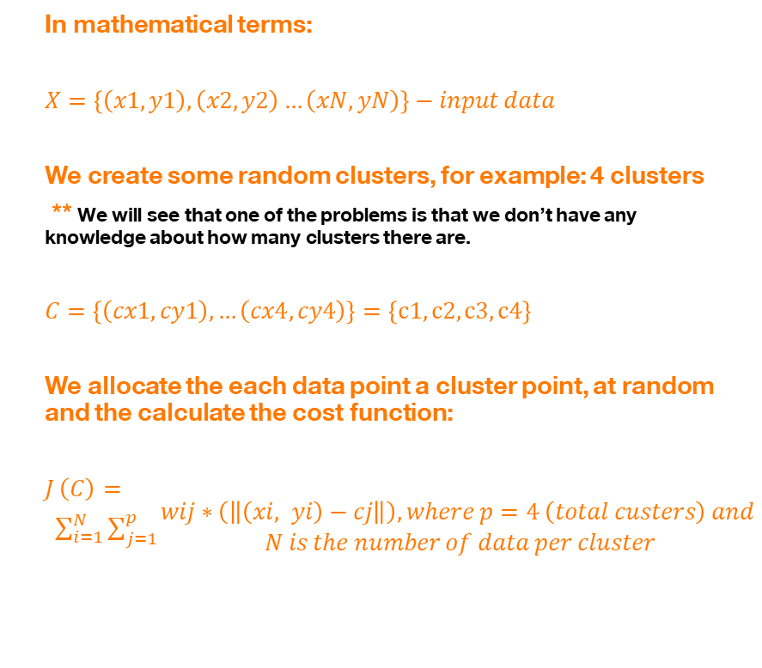
Clustering
In mathematical terms:
$X=\left\{\left(x1, y1\right), \left(x2, y2\right)…\left(xN, yN\right)\right\}−input data$
We create some random clusters, for example: 4 clusters
** We will see that one of the problems is that we don’t have any knowledge about how many clusters there are.
$C=\left\{\left(cx1, cy1\right), …\left(cx4, cy4\right)\right\}=\left\{c1, c2, c3, c4\right\}$
We allocate the each data point a cluster point, at random and the calculate the cost function:
$J \left(C\right)= \sum_{i=1}^{N}{\sum_{j=1}^{p}{\begin{aligned}wij∗\left(\left\|\left(xi, yi\right)−cj\right\|\right), where p=4 \left(total custers\right) and \\ N is the number of data per cluster\end{aligned}}}$
K-Means

Slide 12
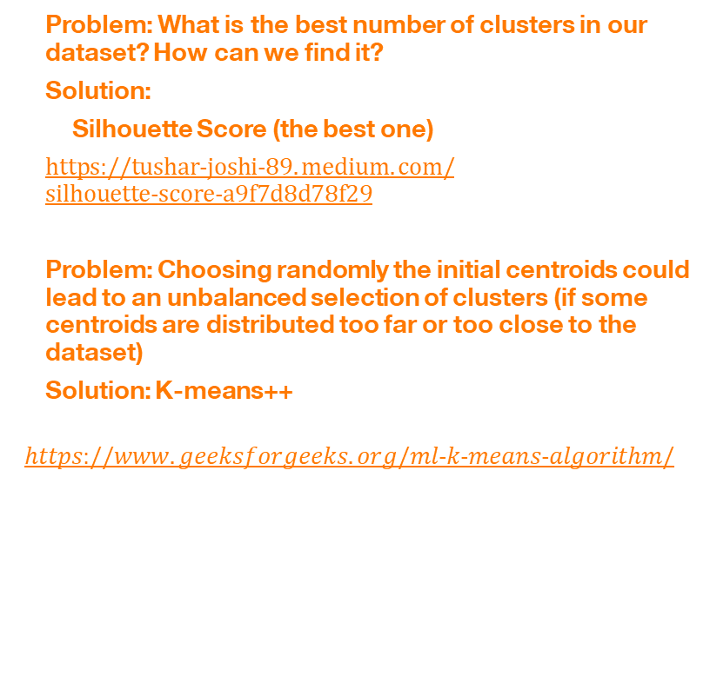
Further research
Problem: What is the best number of clusters in our dataset? How can we find it?
Solution:
Silhouette Score (the best one)
$https://tushar−joshi−89.medium.com/silhouette−score−a9f7d8d78f29$
Problem: Choosing randomly the initial centroids could lead to an unbalanced selection of clusters (if some centroids are distributed too far or too close to the dataset)
Solution: K-means++
$$https://www.geeksforgeeks.org/ml−k−means−algorithm/$$
K-Means

Slide 13
References
https://sites.google.com/site/dataclusteringalgorithms/k-means-clustering-algorithm

Slide 14
Thanks

